Slide 1

Java II

Slide 2

Chapter 16
Files and Streams

Slide 3


Files and Streams: definition
• Files—these exist on a local file system
• Streams—these represent a “stream” of characters coming from some location.

Slide 4
Files and Streams
• Before you can read from a file, you must open it.
• After you are done reading from a file, you must close it.

Slide 5
Files and Streams
• There are two common varieties of reading:
—reading characters ( a character is 16 bits long)
—reading bytes ( a byte is 8 bits long)

Slide 6
Reading Characters

Slide 7

Reading Characters
• When we say we want to read characters, it means we never want to move things like images.
• Each of the bubbles in the list below represents a Java class that is designed to read a certain type of character. Each of these is designed for a particular case.
Reader is an abstract class

Slide 8
Writing Characters

Slide 9
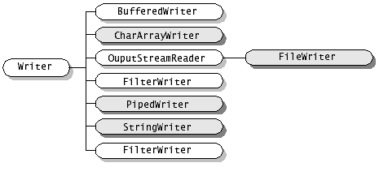
Writing Characters
• When we are writing characters, the same idea applies.
• Each of the bubbles in the list below represents a Java class that is designed to write a certain type of character. Each of these is designed for a particular case.
Writer is an abstract class

Slide 10
Reading Bytes

Slide 11
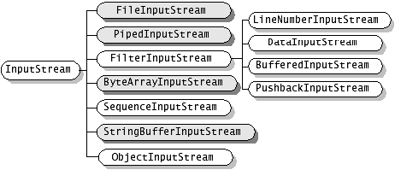
Reading Bytes
• Below is the list of classes you use when you want to read at a finer grain than just characters. That would be bytes.
InputStream is an abstract class

Slide 12
Writing Bytes

Slide 13
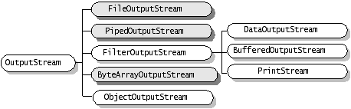
Writing Bytes
• Below is the list of classes you use when you want to write bytes.
OutputStream is an abstract class

Slide 14
General Approach

Slide 15
General Approach
• Inevitably, when you sit down to read from a file, you have to sort through the choices on those lists.
• The best approach is to pick one from either list—character and byte—and learn to use it.

Slide 16
Reading Characters
from a File

Slide 17
Reading Characters from a File
• Say you want to read from a file:
• You will need to open the file.
• You will need to read from the file to the end.
• You will need to close the file.

Slide 18
Reading Characters from a File
• First of all, what is a file?
• A file is an instance of the class File
import java.io;
public class FileRead
{
public FileRead()
{
File inFile = new File( “C:/orig/aFile.txt” );
}
public static void main( String[] args )
{
FileRead fr = new FileRead();
}
}
All the classes used in I/O come from this package.

Slide 19
Reading Characters from a File
import java.io;
public class FileRead
{
public FileRead()
{
try
{
File inFile = new File( “C:/orig/aFile.txt” );
}
catch( IOException io )
{
System.out.println( “IOException, io=“ + io );
}
}
public static void main( String[] args )
{
FileRead fr = new FileRead();
}
Because the constructor on File throws an IOException, we are forced to place it in a try-catch block

Slide 20
public class FileRead
{
public FileRead()
{
try
{
File inFile = new File( “C:/orig/aFile.txt” );
File outFile = new File( “C:/final/outFile.txt” );
FileReader fr = new FileReader( inFile );
FileWriter fw = new FileWriter( outFile );
int c = 0;
boolean keepReading = true;
while( keepReading )
{
c = fr.read();
if( c == -1 )’
{
keepReading = false;
}
else
{
fw.write( c );
}
}
fr.close();
fw.close();
}
What is this? We read a character but store it as an integer?
That’s right. Although we read an int, the FileWriter understands that it needs to write these as characters.

Slide 21
Reading Bytes
from a File

Slide 22
Reading Bytes from a File
• The approach for reading bytes is nearly the same.
• The difference comes in the classes we choose to do the reading and writing.

Slide 23
public class FileRead
{
public FileRead()
{
try
{
File inFile = new File( “C:/orig/aFile.txt” );
File outFile = new File( “C:/final/outFile.txt” );
FileInputStream fis = new FileInputStream( inFile );
FileOutputStream fos = new FileOutputStream( outFile );
int c = 0;
boolean keepReading = true;
while( keepReading )
{
c = fis.read();
if( c == -1 )’
{
keepReading = false;
}
else
{
fos.write( c );
}
}
fr.close();
fw.close();
}

Slide 24
Alternatives for Efficiency

Slide 25
Alternatives for Efficiency
• As you can imagine, reading a byte or a character at a time is pretty inefficient.
• For that reason, there are alternatives.
• The best one is the BufferedReader. This class gathers a chunk of data at a read.

Slide 26
public class FileRead
{
public FileRead()
{
try
{
File inFile = new File( “C:/orig/aFile.txt” );
File outFile = new File( “C:/final/outFile.txt” );
FileReader fr = new FileReader( inFile );
BufferedReader br = new BufferedReader( fr );
FileWriter fw = new FileWriter( outFile );
BufferedWriter bw = new BufferedWriter( fw );
String temp = null;
boolean keepReading = true;
while( keepReading )
{
temp = br.readLine();
if( temp == null)
{
keepReading = false;
}
else
{
bw.write( temp );
}
}
br.close();
fr.close();
bw.close();
fw.close();
}
Now, we have added a BufferedReader, which allows us to read a line at a time.
The BufferedWriter also allows us to write an entire String

Slide 27
File Serialization

Slide 28
File Serialization
• Another variant of the File I/O world is something called Serialization.
• To serialize an object means to take an object in memory and write that object to a file.
• Then, at a later time, the object can be de-serialized and then we have the object—with its state intact—back in memory.

Slide 29
To start, we create an object of type String “myString”
By custom, files of serialized objects end in “.ser”
String myString = new String( “Some important text” );
File myFile = new File( “C:/myFile.ser” );
FileOutputStream out = new FileOutputStream( myFile );
ObjectOutputStream s = new ObjectOutputStream( out );
s.writeObject( myString );
s.flush();
Next, notice we are using a special class called an ObjectOutputStream. This class is designed to serialize objects.
Finally, we see that we are writing an object.

Slide 30

File Serialization
• Finally, let’s take a look at the file that was written by the last screen:

Slide 31
File Serialization
• The process to read from an existing Serialized file is very similar.
File myFile = new File( “C:/myFile.ser” );
FileInputStream in = new FileInputStream( myFile);
ObjectInputStream s = new ObjectInputStream(in);
String myString = (String)s.readObject();
Notice, when you read out the object from serialized file, you need to cast the object back into the type you know it is.

Slide 32
Reading User Input
from the Console

Slide 33
Reading User Input from the Console
• Although it should be easy, you have to consider the user inputting values from the console as reading from a stream.
• Before we look at the program, let’s understand the issues involved:
—Now do we tell it to read?
—How do we tell it to stop reading?

Slide 34
Reading User Input from the Console
• You tell it to read a line by hitting the “return” key on your keyboard.
• To tell it when to stop reading, we need to send in a “sentinel” value. That means, no matter what, stop when you read this “sentinel” value.

Slide 35
String temp = null;
boolean keepReading = true;
InputStream is = System.in;
InputStreamReader isr = new InputStreamReader( is );
BufferedReader br = new BufferedReader( isr );
StringBuffer stuffRead = new StringBuffer();
try
{
while( keepReading )
{
temp = br.readLine();
if( temp == null || temp.length() == 0 )
{
keepReading = false;
}
else
{
stuffRead.append( temp);
}
}
System.out.println( "stuffRead=" + stuffRead.toString() );
}
catch( IOException io )
{
System.out.println( "ConsoleReader Constructor threw an IOException, io=" + io );
}
Here, we see that an entry of spaces is the sentinel value.

